Slide 1


IIT MADRAS BS DEGREE IN
DATA SCIENCE AND APPLICATION
CAPSTONE PROJECT PRESENTATION
Analyzing the Financial Performance of Mudrika Kirana Provision: Insights and Recommendations
PRESENTED BY
Shri Krishna Pandey

Slide 2
Introduction
Organization Background and Problems
Problem Faced/Objectives of the Project Data Collection & Pre-processing Data Analysis & Charts Results and Findings through Analysis Interpretations and Recommendations Thank You
3
4
5
6
AGENDA
7
8
9
10
2

Slide 3
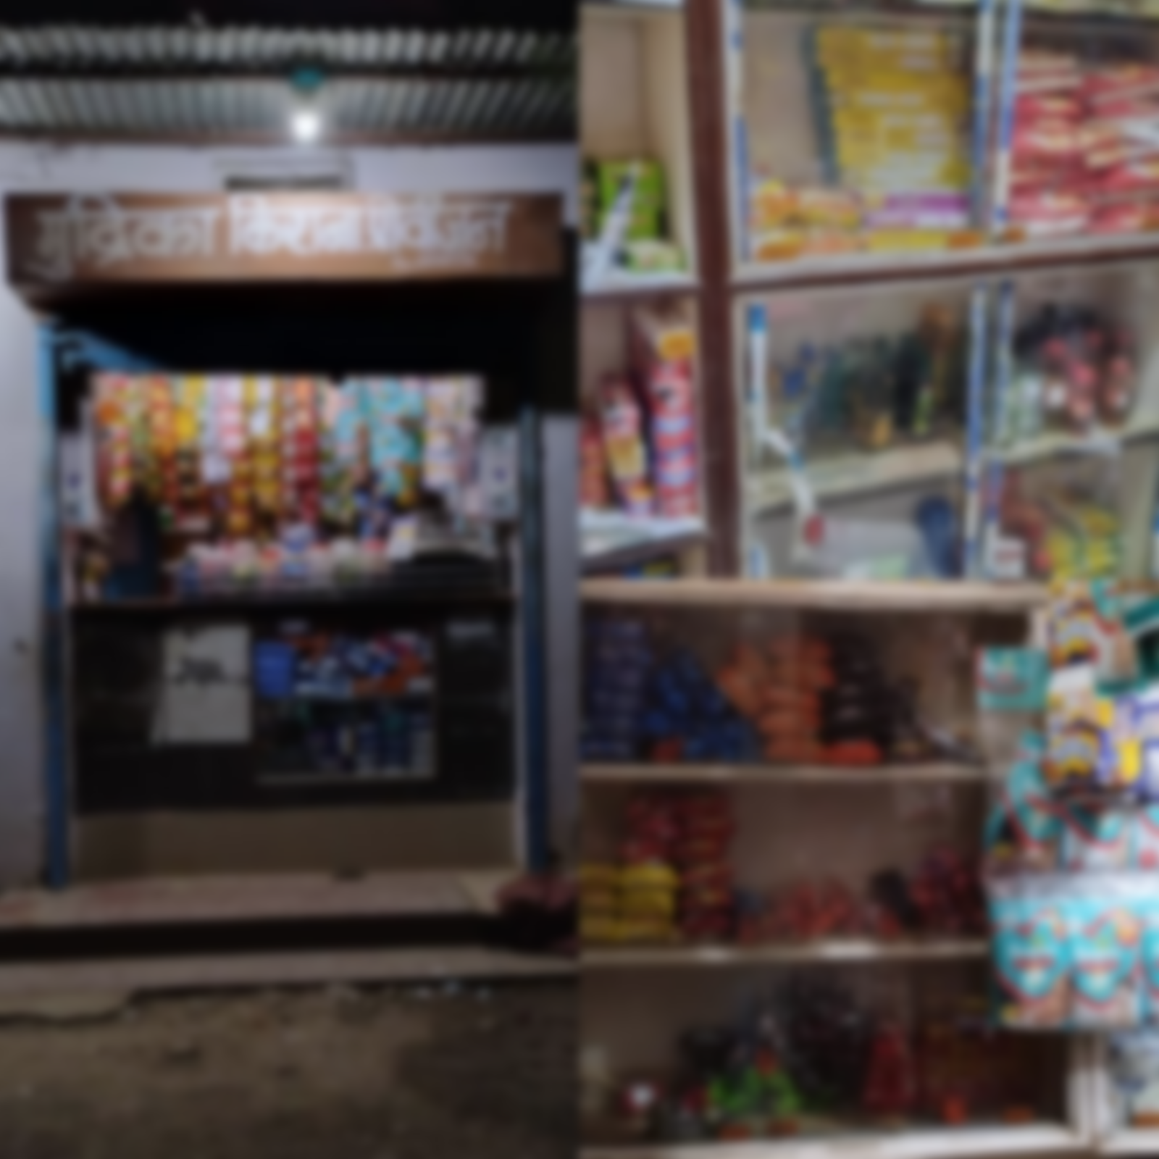
Introduction
Mudrika Kirana Provision (MKP) store analyzed for financial performance in the BDM capstone project
Data collected through physical meetings with the owner, including sale/purchase data and neighborhood survey
Report provides insights on product categories, sales, purchases, and recommendations for improving profits and reducing losses
Small-scale app developed to assist with data management for the store
3

Slide 4
Organization Background & Problems
Mudrika Kirana Provision (MKP) is a Micro-enterprise grocery store located in Ratahara, Rewa, MP est. 2015
Offers grocery, cosmetics, phone recharge, and electric bill payment services
Owner, wife, and children run the shop with limited inventory, and sales data stored in a diary
Serves lower middle-class & workers (labor), has average daily sales of 1700 and 6.5 lakhs p.a. sale.
MKP faces competition from bigger stores and online shopping
Poor inventory management leads to stock-out situations and revenue loss
Lack of data on family-consumed goods results in further loss.
Inability to comprehend daily sales Trends
4

Slide 5
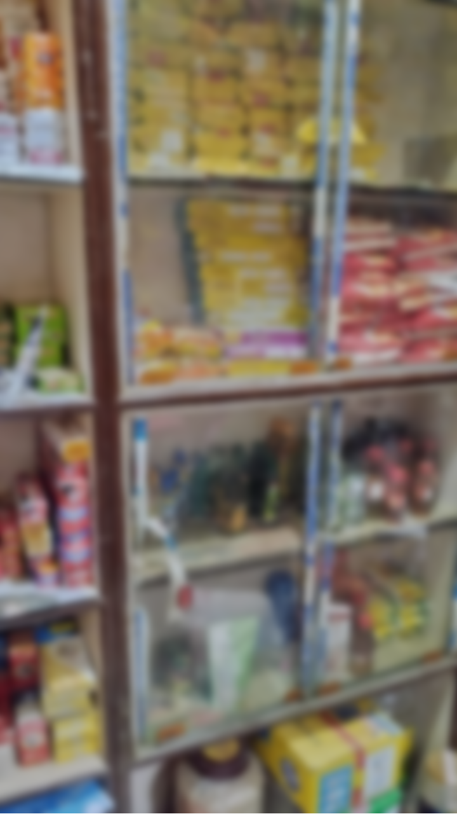
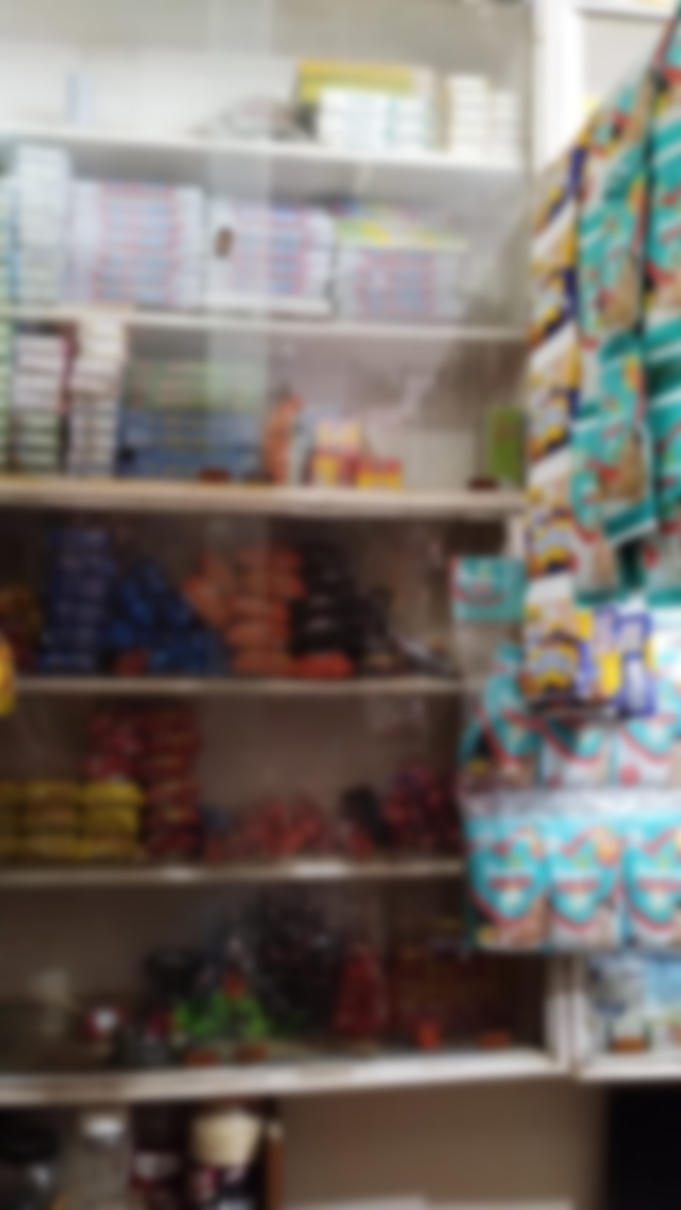
Problem Objectives
Increase customer engagement
Handy spreadsheet, including info on sales, purchases, and expenses
Identify low sales days via sales and purchase data analysis.
Maintain a ledger or database to track family purchases.
5

Slide 6
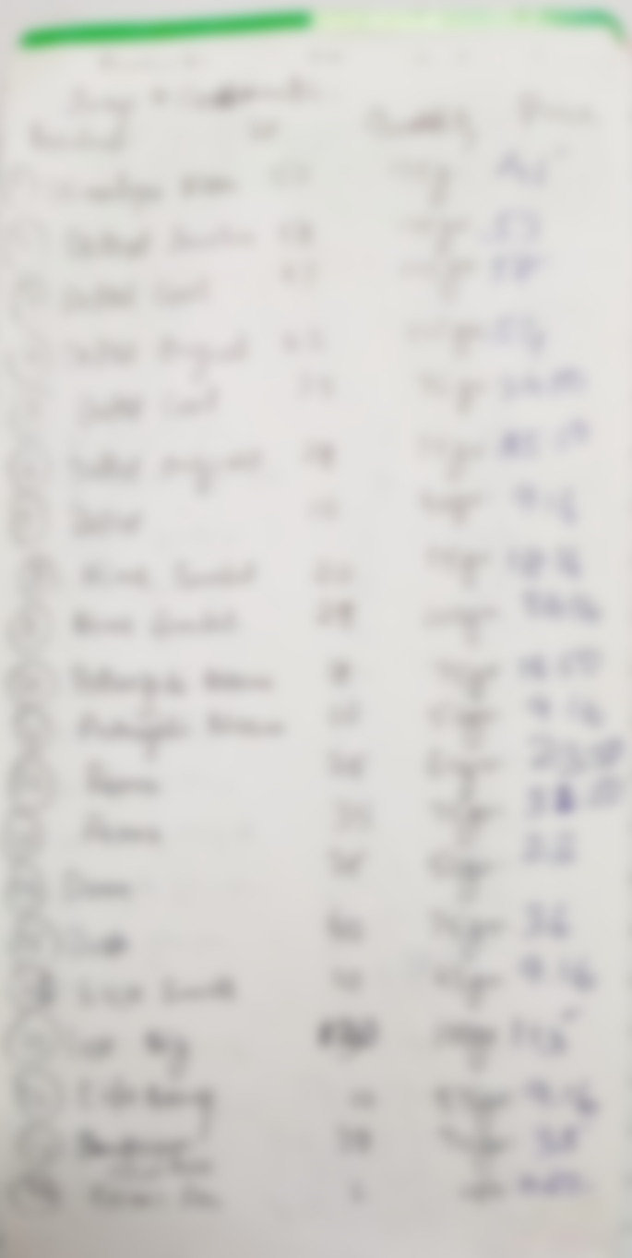
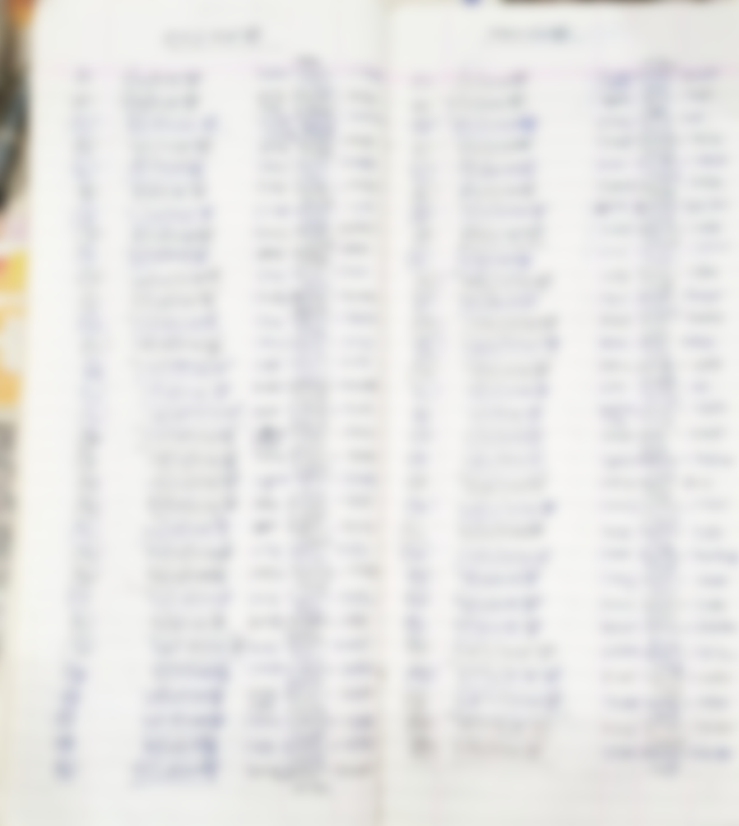
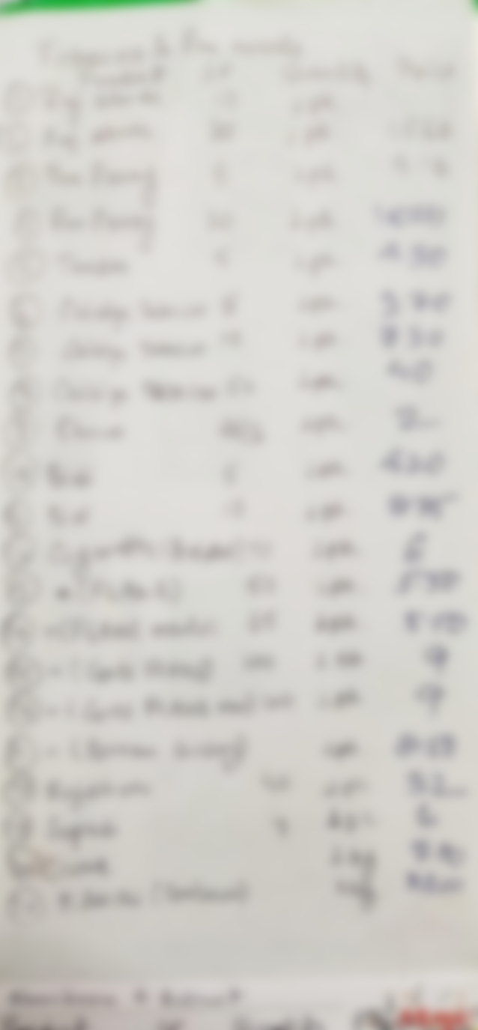
Data Collection & Pre-processing
Analyzed unstructured daily sale and purchase data collected from 2019 to 2022
Created and modified columns as needed
Corrected human errors in calculations and stored them for each day in an Excel sheet.
Shop had scattered product data, so a diary was created to organize details.
200+ product details were collected and logged into an Excel sheet.
6

Slide 7
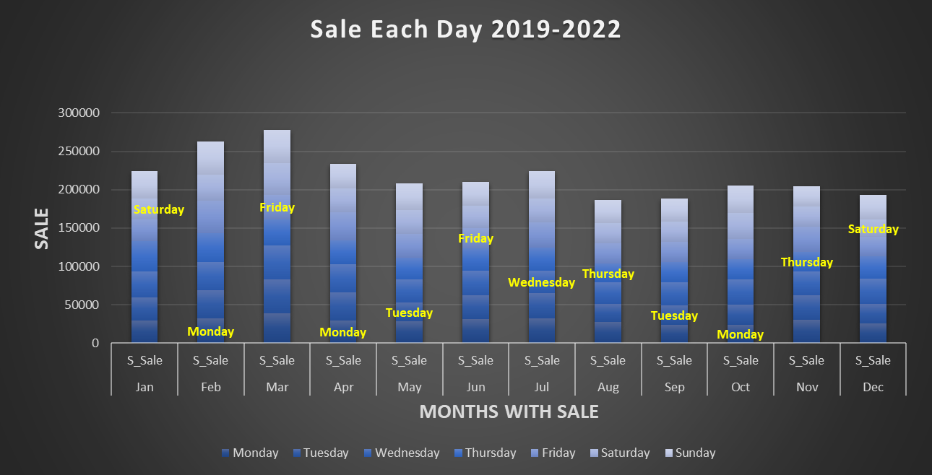
Data Analysis & Charts
Used Microsoft Excel as a primary tool for analysis
Used Excel’s features to display trends and create pivot tables for analysis
Created a pivot table to understand daily sales patterns
Used stacked bar chart and "MIN" function to identify days with lowest sales for each month in all four years
Documenting the results in a report with tables, charts, and visual aids, including recommendations for improving the way data is stored and analyzed in the future.
7
Notes:
Sure, here's a summary of the analysis process and method used in this report in bullet points:
Data pre-processing: Inputting raw data into Excel and performing data pre-processing tasks to ensure the data was ready for analysis.
Data cleaning: Cleaning the unstructured data to remove inconsistencies, duplications, or missing data.
Data analysis: Conducting data analysis using Excel's features such as pivot tables, charts, and functions to understand daily sales patterns and identify the lowest sales days.
Correction of human error: Correcting human errors in the calculations using Excel.
Reporting: Documenting the results in a report with tables, charts, and visual aids, including recommendations for improving the way data is stored and analyzed in the future.

Slide 8
Findings & Results
Identified Categories with the highest margin
Connecting digitally will help in gaining profit
Monday and Saturday are underperforming day
Date | Sale | Purchase | Current | Extra
01-01-2022 | ₹ 0.00 | ₹ 0.00 | ₹ 3,661.00 | ₹ 0.00
02-01-2022 | ₹ 1,618.00 | ₹ 1,300.00 | ₹ 3,979.00 | ₹ 0.00
03-01-2022 | ₹ 1,100.00 | ₹ 3,613.00 | ₹ 1,466.00 | ₹ 0.00
04-01-2022 | ₹ 1,064.00 | ₹ 799.00 | ₹ 1,731.00 | ₹ 0.00
05-01-2022 | ₹ 2,632.00 | ₹ 2,710.00 | ₹ 1,653.00 | ₹ 0.00
06-01-2022 | ₹ 1,998.00 | ₹ 1,910.00 | ₹ 1,741.00 | ₹ 0.00
07-01-2022 | ₹ 1,035.00 | ₹ 1,140.00 | ₹ 1,636.00 | ₹ 0.00
08-01-2022 | ₹ 1,586.00 | ₹ 595.00 | ₹ 2,627.00 | ₹ 0.00
09-01-2022 | ₹ 1,855.00 | ₹ 1,000.00 | ₹ 3,482.00 | ₹ 0.00
10-01-2022 | ₹ 900.00 | ₹ 1,120.00 | ₹ 3,262.00 | ₹ 0.00
Provided Structured Data
Understood selling pattern of the local area
8

Slide 9
Interpretations & Recommendations
Excel spreadsheets can help reduce losses due to human error
Monday and Saturday can be used as shopping days for owner
Investing more in certain products can maximize profits
Local shops are underperforming compared to shops on highways or big markets
Locals prefer to buy lower-quality substitutes for branded products
Improve shop visibility through offline and online signage/banners
Diversify products with lower price range to attract more customers
Connecting digitally will benefit the client, as other local businesses are less active online
Implement loyalty programs or incentives for repeat customers to encourage retention and increase sales
9

Slide 10
THANK YOU.
EMAIL
shrikrishnapandey72@gmail.com
This ending has a new beginning.
10

